Slide 1
Hanwha Group
2021 Global Communications Workshop

Slide 2
About Hanwha Newsletter Overview

Slide 3
Hanwha NEWSLETTER
Hanwha Newsletter
Hanwha Group Launched Hanwha Newsletter in the year of 2015, September.
1971
Launched the Group magazine <The Dynamite Press>
1992
Hanwha Broadcasting Center opened Changed the Group magazine title to <Hanwha>
1999
Changed the Group magazine title to <Hanwha & Hanwha People>
2015
Launched Hanwha Newsletter
2016
Launched Internal Digital Communication Platform <Channel H>

Slide 4
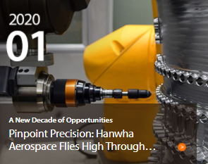
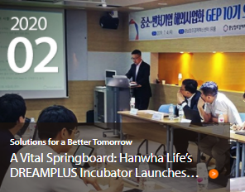
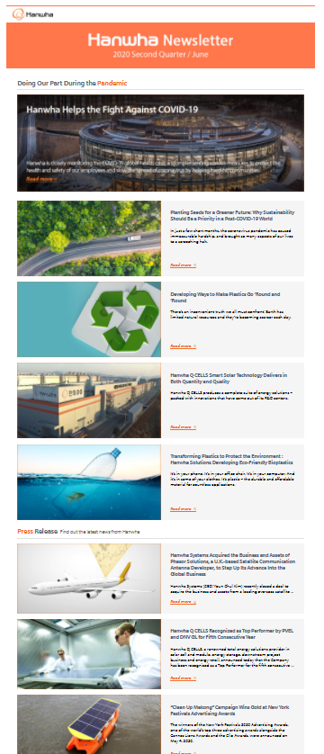
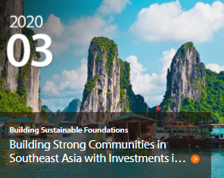
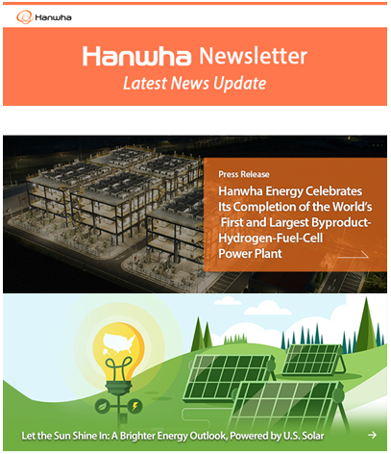
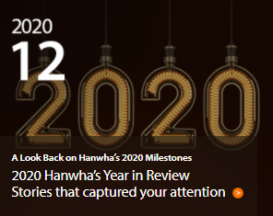
Hanwha NEWSLETTER
Goals & Objectives
The Hanwha Newsroom and Newsletter are Hanwha Group channels for external and internal branding and communication, focused on news and updates from all Hanwha companies and affiliates around the world
Keeps employees informed on the group’s global businesses
Communicates group’s vision and values
Lets employees feel connected with their peers globally

Slide 5
Hanwha NEWSLETTER
Overview
Launched as group’s global employees’ internal communication channel (Sep. 2015)
Quarterly and ad hoc issues (press release or special issue)
Published 158 times so far
Email/ PC/ mobile/ WeChat versions
Target
Publication
Channel
Language
Group local employees &
expats
Quarterly and
ad hoc issues
Hanwha.com
Email/PC/ mobile/ WeChat
Published in English and Chinese

Slide 6
Hanwha NEWSLETTER
Global Newsletter Key Figures
Improving employees’ understanding of the group and key businesses through various types of contents
Published a total of 930 contents (September 2015 – December 2020)

Slide 7
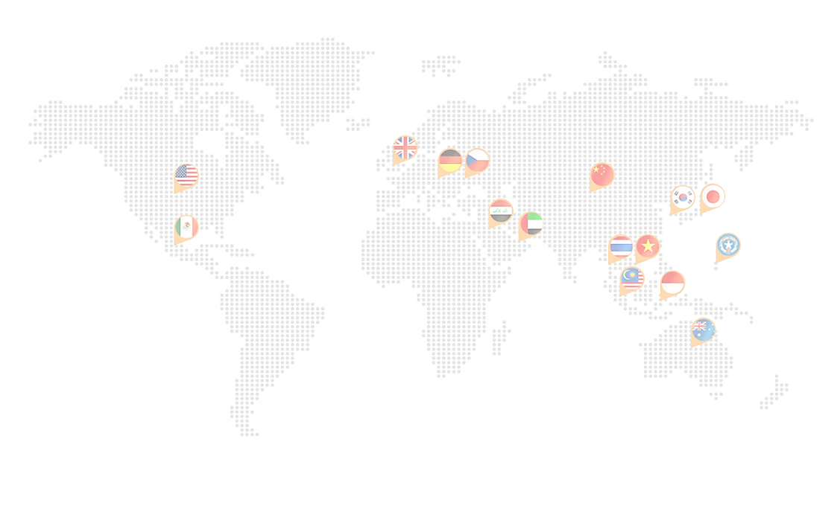
Hanwha NEWSLETTER
Global Newsletter Key Figures
Hanwha Life, Hanwha Q CELLS, and Hanwha Chemical have been most active, while Sino-Korea Life, Hanwha Life Vietnam, and Hanwha Q CELLS GmbH have shown most activity among stand alone corporations
Global Reporters activities
A total of 36 cases of
Global corporations and affiliates news delivered
(2020.01~2020.12)
[ Number of articles by company]
[Number of articles by subsidiary]
Rank | Company | No. of articles
1 | Hanwha Life | 16
2 | Hanwha Q CELLS | 6
3 | Hanwha Chemical | 4
Rank | Company | No. of articles
1 | Sino-Korea Life Insurance | 7
2 | Hanwha Life Insurance Company Limited (Vietnam) | 6
3 | Hanwha Q CELLS GmbH | 4

Slide 8
Hanwha NEWSLETTER
Global Newsletter Key Figures
Newsletter subscription trend past 4 years
Other than the number of employees, public readers of the Global Newsletter via the Group Global Newsroom has been increasing rapidly every year
 | 2017 | 2018 | 2019 | 2020 | Remarks
Q1 | 1,121 | 1,011 | 759 | -325
Q2 | 949 | 984 | 488 | 667
Q3 | 2,408 | 1,042 | 409 | 416
Q4 | 2,368 | 1,160 | 872 | -
Total. New subscribers | 6,846 | 4,197 | 2528 | 758
Total accumulated no. of subscribers | 7,921 | 16,692 | 18,063 | 19,693 | +8.2%
Accumulated No. of Subscribers
8
New subscribers by each quarter and total accumulated no. of subscribers

Slide 9
Hanwha Newsletter Annual Review
Contents

Slide 10
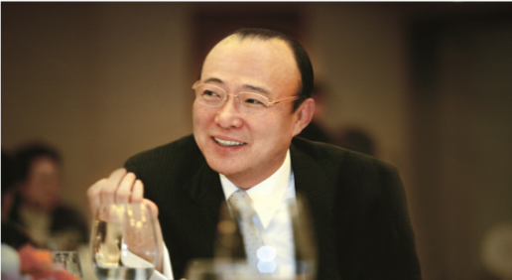
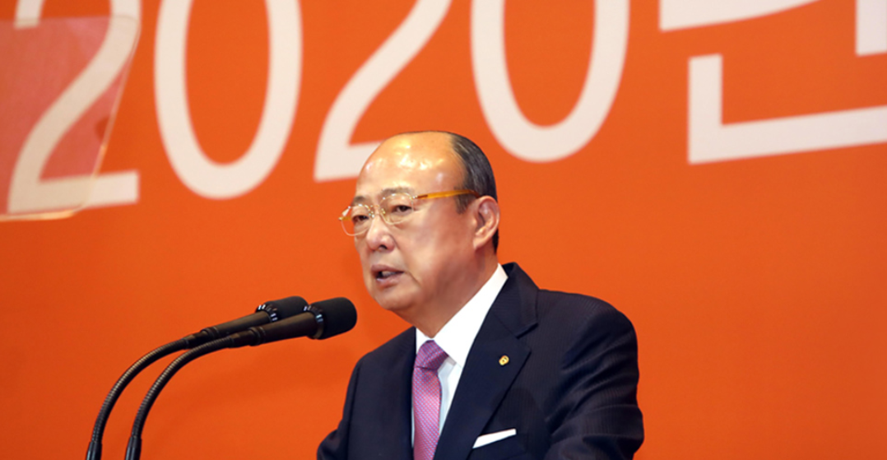
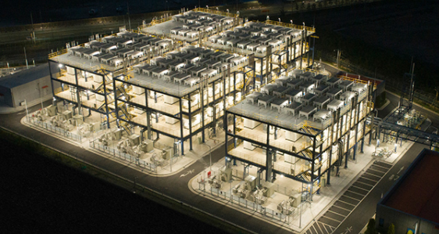
Hanwha NEWSLETTER
Most Viewed Contents Top 3
From launch (September 2015) to present
No. 1 Photo Contest
No. 2 2019 New years message from chairman Kim
No. 3 2020 New years message from chairman Kim
Last 1 year
No. 1 2020 New years message from chairman Kim
No. 2 Hanwha helps the fight against covid-19
No. 3 Hanwha energy celebrates its completion of the worlds first ~

Slide 11
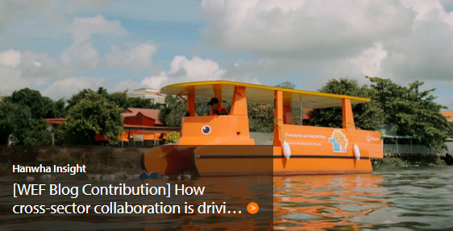
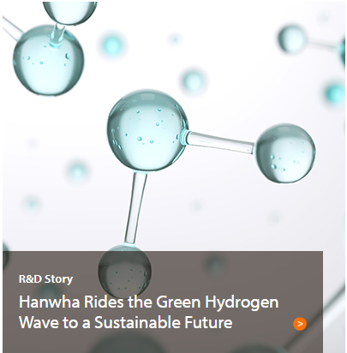
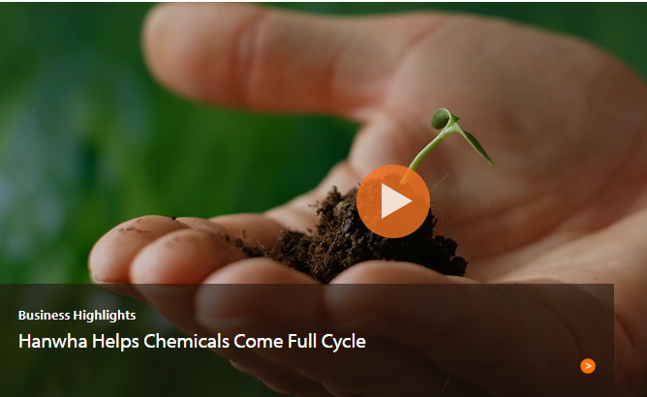
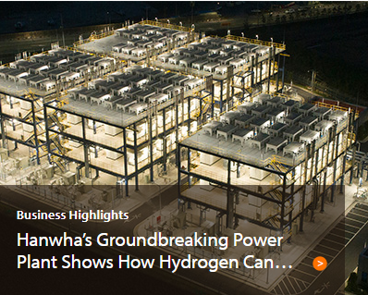
Hanwha NEWSLETTER
Contents Highlight
Business Feature Articles (1) – Key momentum targeted contents

Slide 12
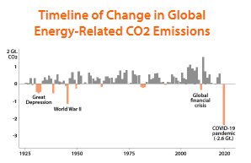
Hanwha NEWSLETTER
Contents Highlight
Business Feature Articles (2) – Thought leadership contents

Slide 13
Hanwha Newsletter Annual Review
Global Channels

Slide 14
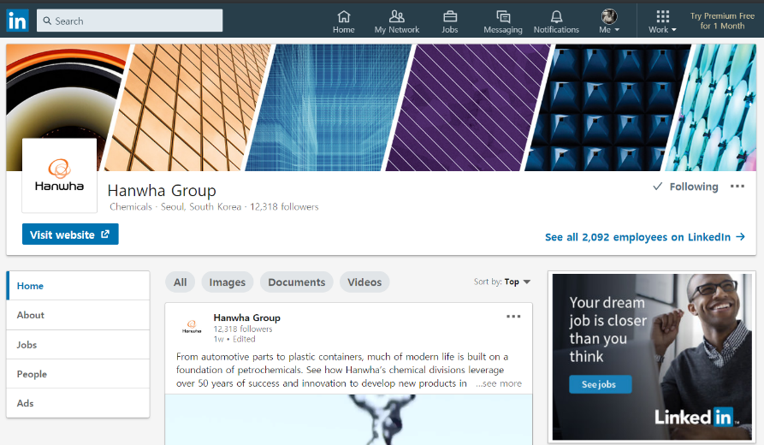
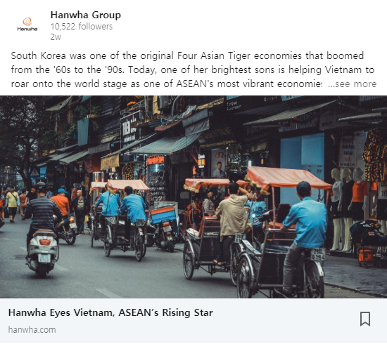
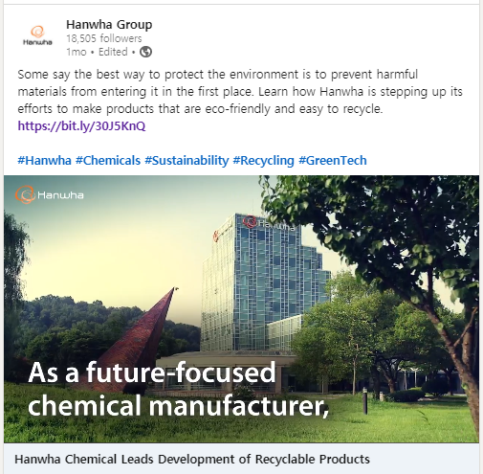
Hanwha NEWSLETTER
Global Social Channel: LinkedIn
Exposes Newsroom contents to audience within and outside of Hanwha (as of Jan. 19, 2021, 19,455 followers)
Contributes to increase of engagement and growth of external audiences for Newsroom by offering key contents of each business and timely news contents
Executes content advertisements with focus on Impressions, targeting B2B audience by industry

Slide 15
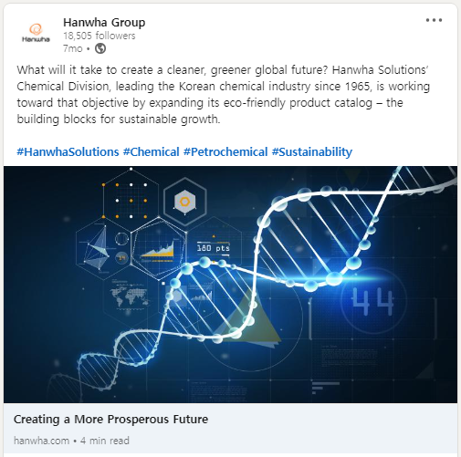
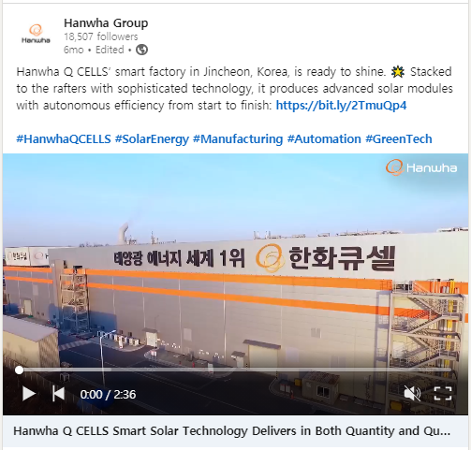
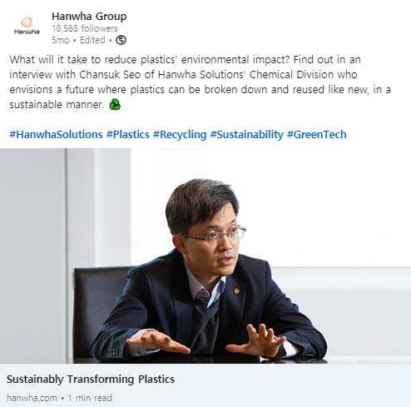
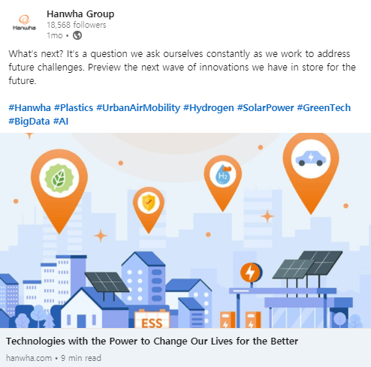
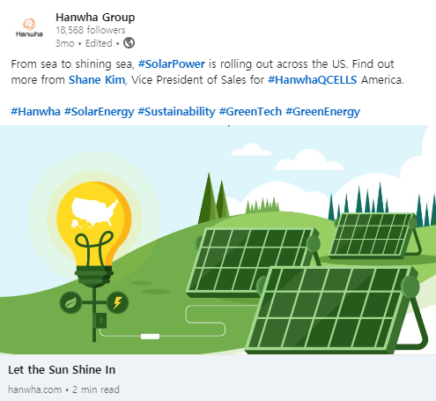
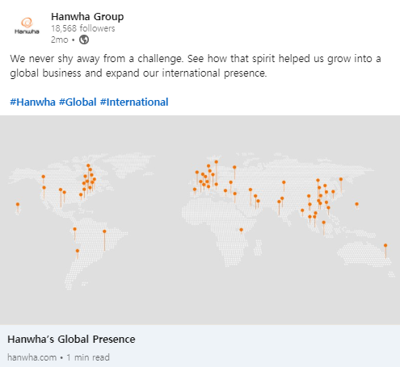
Hanwha NEWSLETTER
Global Social Channel: LinkedIn Contents Highlight
Industry Insight Contents
Employee-related Contents
Business Introduction Contents

Slide 16
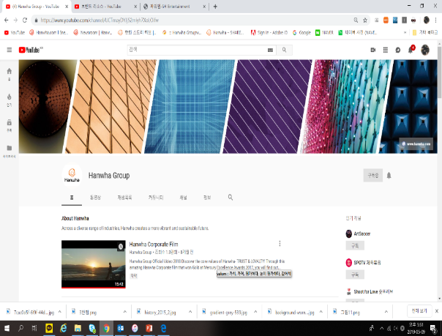
Hanwha NEWSLETTER
Global Social Channel: YouTube
Introduce Hanwha’s affiliates and businesses through videos (9 categories) → About Hanwha / Sustainability / Leisure & Lifestyle / Aerospace & Mechatronics / Construction / Financial Services / Solar Energy / Chemicals & Materials / Sports Sponsorship
Introduce Hanwha.com, Newsroom and LinkedIn through YouTube to increase inflow

Slide 18
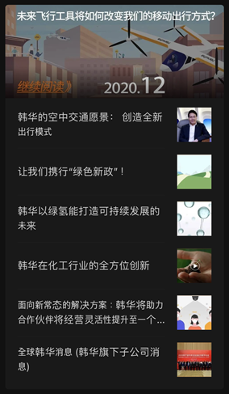
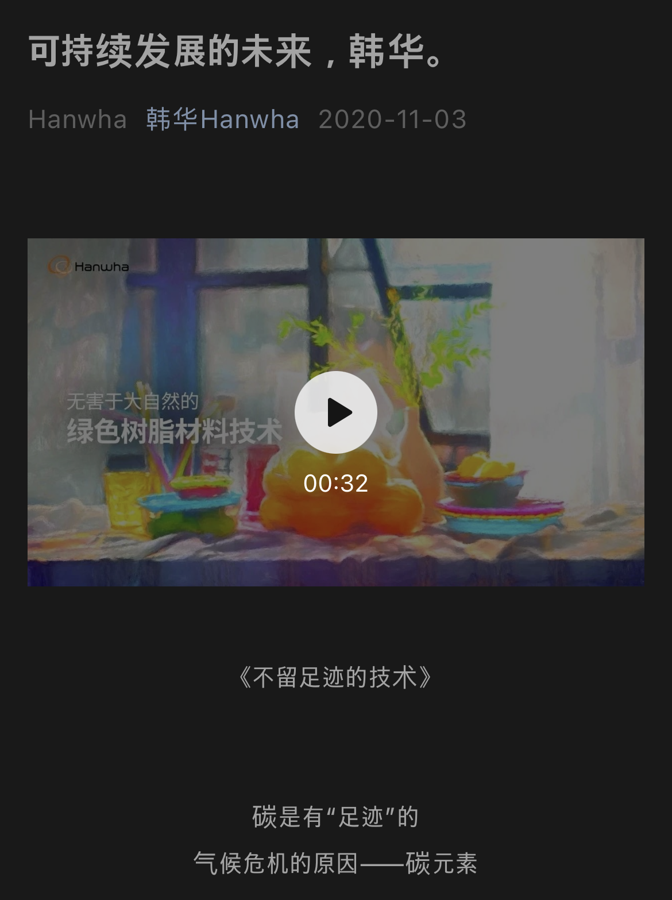
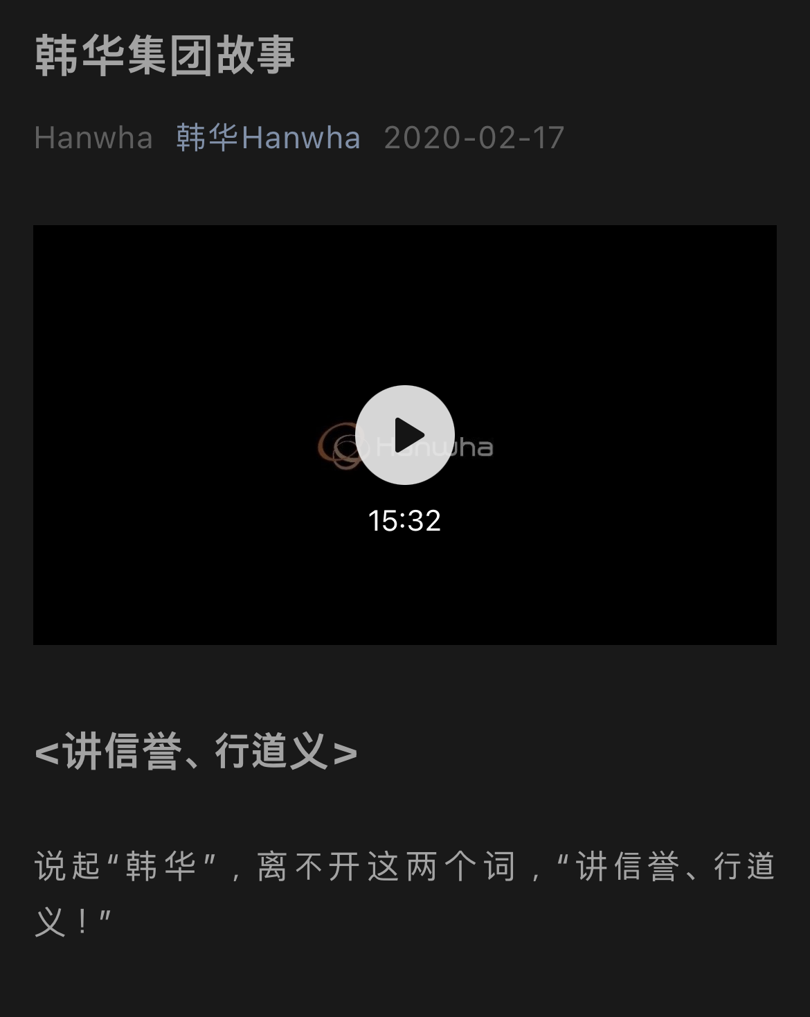
Hanwha NEWSLETTER
Global Social Channel: WeChat
Enhance convenience for Chinese users by building channel specialized for the Chinese market
Induce greater audience to Hanwha.com by issuing Newsletter via WeChat

Slide 19
About Global Reporters

Slide 20
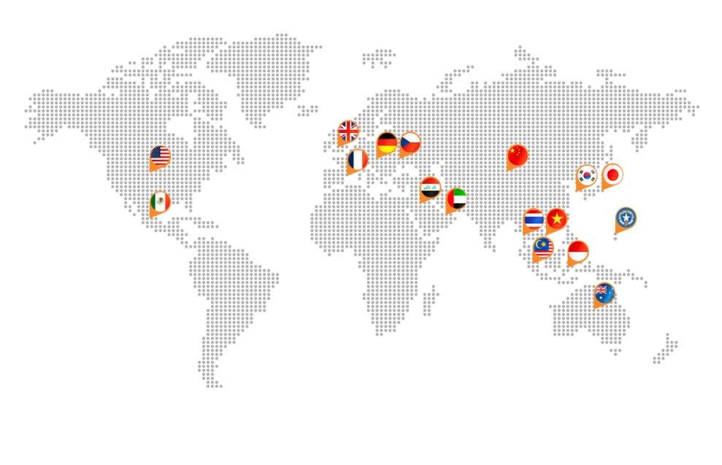
Hanwha GLOBAL REPORTERS
Global Reporters
Ambassadors that deliver news from Hanwha’s overseas corporations as well as spreading Hanwha’s culture and values
From 17 different countries
Represent 39 different regional branches
Diverse backgrounds
: Communications, marketing, sales, planning & management, administration, finance, legal, customer service, etc.
: Assistant managers/Junior employees, Managers/Directors, Team leaders/executives

Slide 21
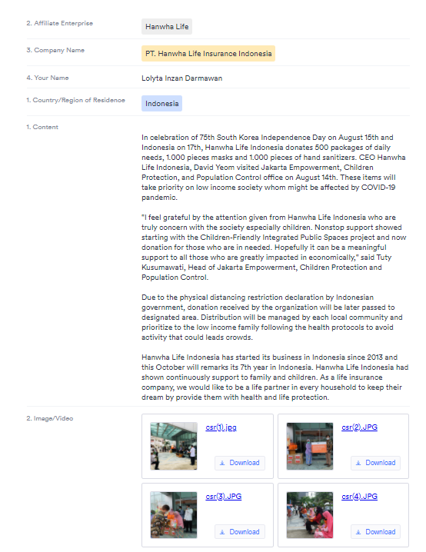
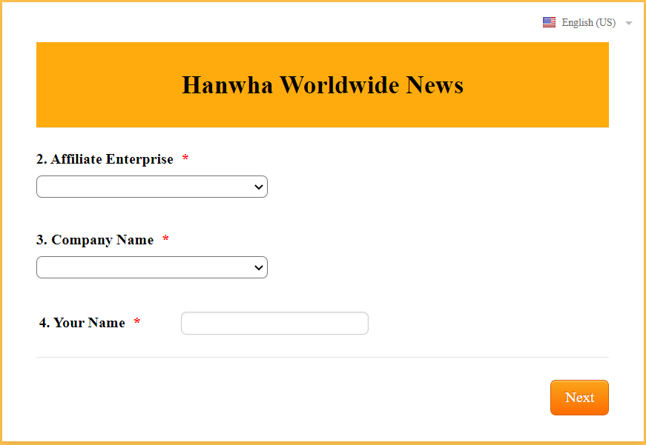
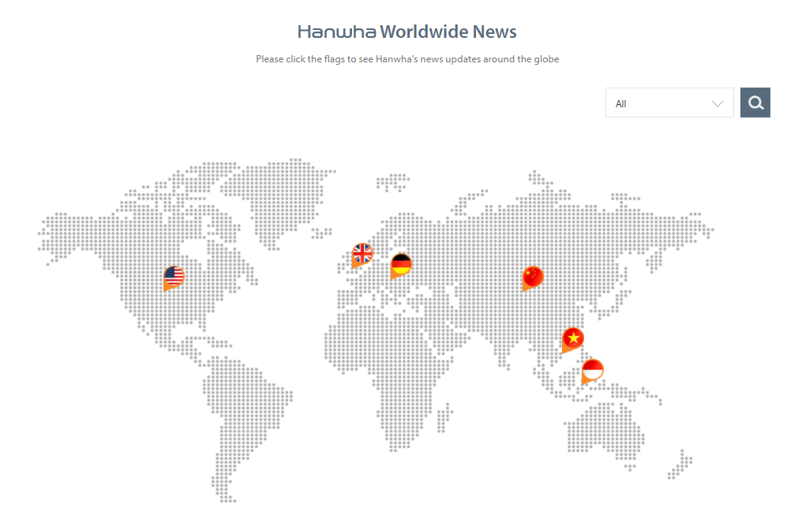
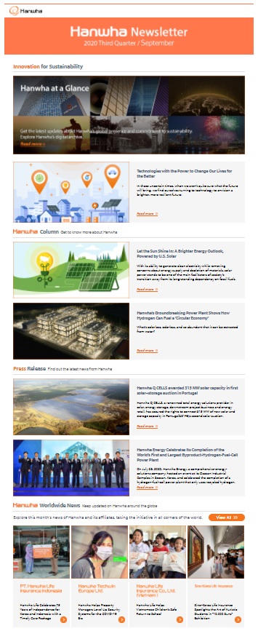
Hanwha GLOBAL REPORTERS
Global Reporters
Hanwha People
Customers

Slide 22
Hanwha GLOBAL REPORTERS
Your Role as a Hanwha Reporter
Identify and contribute compelling stories for Hanwha Newsroom and Newsletter
Encourage colleagues to read stories and possibly also contribute story ideas
Provide feedback or insights on what can be improved
Identify and contribute compelling stories for Hanwha Newsroom and Newsletter
Encourage colleagues to read stories and possibly also contribute story ideas
Provide feedback or insights on what can be improved

Slide 23
Hanwha GLOBAL REPORTERS
Becoming a Hanwha BRAND AMBASSADOR
Connect colleagues with the Hanwha brand story
Align local internal comms efforts
with Hanwha brand story and values
Guide colleagues to better understanding Hanwha Group’s vision, core values, and business
Foster the Hanwha
culture among colleagues

Slide 24
Hanwha GLOBAL REPORTERS
2021 Hanwha Global Reporters
Hanwha Advanced Materials | Geun Han Park
 | Minhee(Ashlee) Park
 | Antonia Holeňová
 | Laura Jasmin Antonia Ilg
 | Edward Lee
 | Haejin Sohn
 | Piao Xing Guo
 | Karla Martinez
 | XUAN YONG QUAN
Hanwha Corporation/Global | Yeo Gyeong Lee
 | Sam Berlin
 | Joseph Park
 | Jake Han
 | David Nam
Hanwha Chemical | Hyewon Park
 | Lian Xuemei
 | Wang Yi
 | Kunkrit Witthayakornkomol
Hanwha Corporation/Machinery | Min Joo Jung
 | Renee Mougin
Hanwha Energy | Min Hee Lee
 | Christine Orlando
 | Julia Koo
Hanwha Techwin | Hyo Jin Pak
 | Jessica Cho
 | Murielle Runnalls
 | Joon-who Park
 | Catherine Tran
Hanwha Q CELLS | Yun Ju Lee
 | Hye Rim Jo
 | Jochen Endle
 | Ian Clover
 | Tobias Bressler
 | Kelsea Jones
 | Adam Bestrom
 | Katayama Junichi
 | Jaebin Lee
 | Loh Wei Jyh (Albert)
 | Hanbit Kim
 | Lili Niu
Hanwha Life | Se Yeon Lim
 | Zhou Wenjuan
 | Tran Thi Thanh Hoa
 | Nguyen Thi Nhu Ngoc
 | Lolyta Inzan Darmawan
Hanwha Aerospace | Beop Min Oh
 | Shaun Carroll
 | Pham Thu Phuong
Hanwha Investment & Securities | Hye Sung Chang
 | Nguyen Thi Huyen Trang
Hanwha Total Petrochemical | Kyu Min Shim
 | Sunny Kim
Hanwha Engineering & Construction | Se Yup Lee
 | Sun Che

Slide 25
Welcome!

